Slide 1
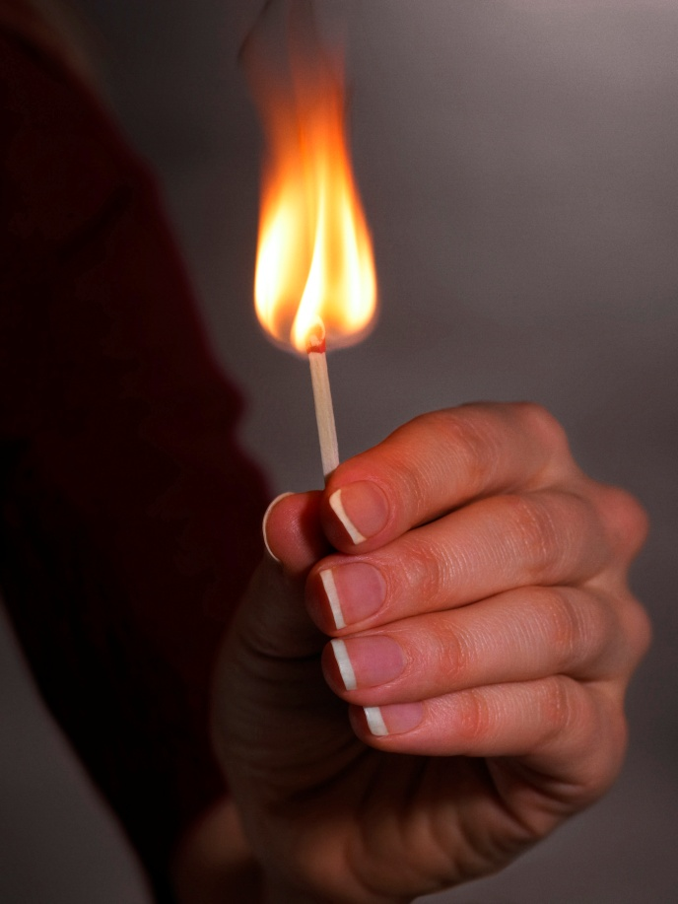

Fire Safety & Prevention

Slide 2
Fire is dangerous
Our state in 2010 -
14,5K
Fires reported
39
Civilian deaths
137
Reported civilian injuries
$152M
Property damage

Slide 3
In the Home
People feel the safest in their homes, however residential properties are where most fires and fire deaths occur.
Structure fires
Structure fires death
Other
(24%)
Other (3%)
Residential properties
(76%)
Residential properties (97%)

Slide 4





Top Fire Causes
*leading cause of fire fatalities

Slide 5
Cooking Fires
Nearly half of all home fires originate in the kitchen
Pay attention to what you’re cooking.
If you leave the room, turn off the stove.
Don’t cook if you’re sleepy or if you’re impaired.

Slide 6
Smoking Related Fires
Cigarettes can smolder for hours.
Tips to avoid smoking related fires:
Don’t smoke inside.
Discard smoking materials in a fire safe container.
Use a proper, heavy ashtray which won’t tip easily.
Don’t improvise!
Smoking is the leading cause of fire deaths.

Slide 7
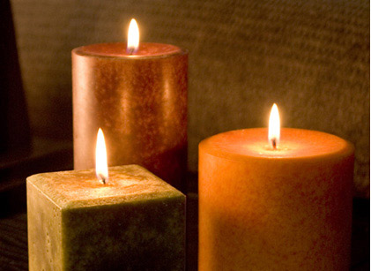
Candles
Unattended candles are a leading fire cause.
Candle safety tips:
Use flameless candles.
When you leave the room, blow out the candle.
Keep anything that could burn at least a foot away.
Don’t set the candles on anything combustible.

Slide 8
Electrical Safety
Do not overload electrical sockets.
Do not run cords under rugs or furniture.
They can become worn, overheat, and cause a fire.
Avoid putting cords against walls or across doorways.
Use power strips equipped with overload protection.
Make sure all power strips and extension cords are tested and approved by a laboratory such as UL (Underwriter’s Laboratories).

Slide 9
Plan Escape Routes
Know your escape routes and practice them.
When the smoke alarm sounds, you may only have seconds or minutes to escape safely.
Have a meeting place for everyone to gather outside.
Plan two ways out, in case one way is filled with smoke or fire.
BEDROOM
BEDROOM
BEDROOM
LIVING ROOM
Kitchen
FAMILY ROOM
X
Meeting Place

Slide 10




Have Safety Elements
Smoke
Alarm
Make sure you can hear the alarm in every place in your home.
They should be loud enough to wake you from sleep.
Carbon Monoxide
Alarm
Law requires carbon monoxide alarms in all homes, within ten feet of all sleeping areas.
Fire
Extinguishers
Have them mounted in an obvious spot near an exit.
Know how to use them.
Residential Fire Sprinkler Systems
90% of fires are contained by the operation of just one sprinkler.

Slide 11
If you have a fire…
Step 1
Leave
Close the door
Call 911 from outside
Once you’re out, STAY OUT
Step 2
Report ALL fires to the fire department, even if you think you put them out!

Slide 12
Summary
There are many ways to reduce your risk of fire:
Stay focused when you’re cooking.
Use candles responsibly, or don’t use at all.
Don’t overload electrical sockets
If you must smoke, be responsible for your smoking materials.
Have a fire safety plan and practice it!
Have working smoke and CO alarms.
Be responsible.

